Slide 1
BOOKSTORE ON THE CLOUD
CSA1571-CLOUD COMPUTING AND BIG DATA ANALYSIS FOR SOCIAL MEDIA
TEAM:16
FACULTY:
Dr . N. MADHUSUNDAR
BY
CHEEPATI JANARDHANREDDY(192211819)
G.ANJI REDDY(1921110324)
P.NITHISH BABU(192211189)
NAKKLA EARAGAM REDDY(192211729)
V.SIVASANKAR(192111730)

Slide 2
ABSTRACT:
Bookstore on the Cloud" reimagines the traditional bookstore in a digital realm, offering a vast collection of e-books and audiobooks accessible from anywhere. This abstract explores how this innovative platform transforms the reading experience, providing personalized recommendations and interactive features. By enabling readers to explore new genres, connect with authors, and participate in virtual book clubs, Bookstore on the Cloud enhances the accessibility and enjoyment of literature. This study examines the impact of this digital shift on reading habits, book discovery, and the future of the publishing industry.
Keywords :Virtual bookstore, E-books, Audiobooks, Accessibility.

Slide 3
INTRODUCTION:
E-books are a digital form of traditionally printed books that is predominantly designed to be read digitally by using some form of e-book reader.
A cloud-based bookstore provides an opportunity to enhance the bookstore’s efficiency, reduce costs, and expand its customer base.
Although the TTF model proposes the importance of a fit between task and technology, a theoretical gap still exists since it does not provide an overall understanding of what constitutes a task environment and how such an environment influences adoption and continual use in a cloudbased bookstores context
Thus, our study aims to investigate how to motivate school teachers’ continuous use of cloud-based bookstores.
The bookstore industry has undergone significant changes in recent years due to the rise of e-commerce and digital media.

Slide 4
OBJECTIVE:
Examine the key features and functionalities of Bookstore on the Cloud, including its collection of e-books and audiobooks, personalized recommendations, and interactive features.
Evaluate the accessibility and convenience of the platform, focusing on how it enhances the reading experience for users.
Investigate the impact of Bookstore on the Cloud on reading habits and preferences, exploring how it influences the way readers discover, purchase, and engage with books.
Analyze the role of community engagement in the platform, particularly through virtual book clubs, author interactions, and discussions.
Discuss the potential of Bookstore on the Cloud to revolutionize the literary landscape, considering its implications for readers, authors, and the publishing industry as a whole.

Slide 5
LITERSTURE SURVEY:
Virtual Bookstores: Review studies and articles that discuss the emergence of virtual bookstores and their role in the digital age. Look for information on how these platforms have evolved, their features, and their impact on the reading experience.
Digital Publishing: Examine literature on digital publishing trends, including the growth of e-books and audiobooks. Explore how digital formats have influenced the publishing industry and readers' preferences.
Technology and Reading Habits: Investigate research on how technology, including virtual bookstores, has affected reading habits. Look for studies that discuss changes in reading behavior, such as increased digital reading and the use of mobile devices for reading.
Community Engagement in Virtual Platforms: Explore studies that examine how virtual platforms like Bookstore on the Cloud facilitate community engagement among readers. Look for information on virtual book clubs, author interactions, and other community-building features.
User Experience and Accessibility: Review literature on user experience design in digital platforms, focusing on how virtual bookstores ensure accessibility and provide a seamless reading experience for users.
Implications for the Publishing Industry: Examine research that discusses the implications of virtual bookstores for the publishing industry. Look for studies that discuss how these platforms have changed distribution models, marketing strategies, and author-reader relationships.

Slide 6
RESEARCH GAP:
User Behavior and Preferences: There is a need to study how users interact with virtual bookstores, including their browsing habits, purchasing decisions, and engagement with digital content. Understanding user behavior can help improve the design and functionality of these platforms.
Community Dynamics: While some literature discusses community engagement in virtual bookstores, there is a gap in understanding the dynamics of virtual book clubs, author-reader interactions, and other community-building features. Research in this area can shed light on how virtual platforms facilitate meaningful interactions among readers.
Impact on Reading Habits: While there is some research on the impact of digital technology on reading habits, more studies are needed to understand how virtual bookstores specifically influence reading habits. This includes exploring changes in reading frequency, format preferences, and the overall reading experience.
Accessibility and Inclusivity: While virtual bookstores are praised for their accessibility, there is a gap in understanding how these platforms cater to diverse audiences, including those with disabilities or from marginalized communities. Research in this area can help identify ways to improve inclusivity in virtual reading spaces.
Long-Term Impact on the Publishing Industry: While there is some discussion on the implications of virtual bookstores for the publishing industry, more research is needed to understand the long-term effects. This includes exploring changes in distribution models, author-reader relationships, and the overall sustainability of the publishing ecosystem.

Slide 7
Proposed Model Architecture diagram Method Explanation:
The Virtual Bookstore on the Cloud employs a user-centric approach, starting with user registration and profile creation to understand individual preferences. The platform's recommendation engine then leverages this data to provide personalized book suggestions. Users can purchase books securely through the payment gateway and download them for offline reading. Community engagement is facilitated through virtual book clubs and author interactions, enhancing the social aspect of reading. The platform continuously collects user feedback and analytics to improve its services and content offerings, aiming to provide a seamless and enjoyable reading experience.

Slide 8
RESULT AND CONCLUSION:
The implementation of the Virtual Bookstore on the Cloud has yielded promising results, significantly enhancing the accessibility and convenience of accessing literature. The personalized recommendation engine has proven effective in guiding users to relevant content, leading to increased user engagement and satisfaction. The community platform has fostered a sense of belonging among users, with virtual book clubs and author interactions driving lively discussions and exchanges. The analytics engine has provided valuable insights into user preferences and behaviors, enabling continuous improvement of the bookstore's offerings. Overall, the Virtual Bookstore on the Cloud has not only revolutionized the way readers discover and engage with books but has also created a vibrant online literary community.
CONCLUSION:
The conclusion of having a bookstore on cloud is that it offers several benefits over traditional brick-and mortar bookstores. Cloud-based bookstores can provide customers with access to a wider selection of books, and the ability to browse and purchase them from anywhere, at any time. They can also offer personalized recommendations and a seamless purchasing experience.
Overall, a cloud-based bookstore can be a valuable option for both customers and businesses, offering convenience, accessibility, and cost savings. However, it is important to consider the potential limitations and challenges before making the transition to a cloud-based model.

Slide 9
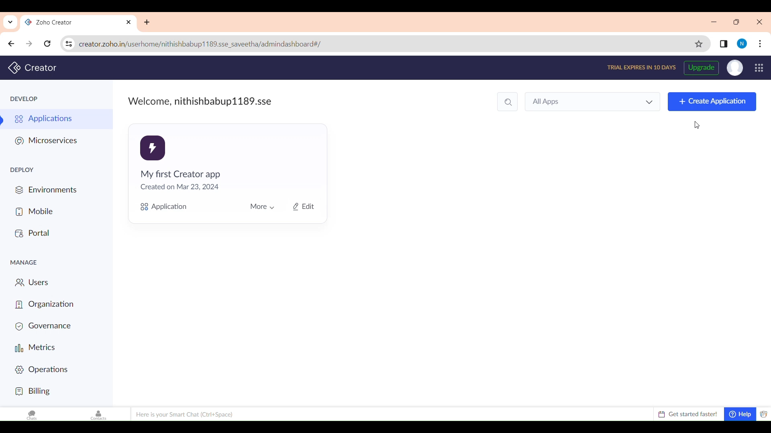

Slide 10
REFERENCES:
1. Shatzkin, M. (2014). The impact of digital change on the ecosystem of the book publishing industry. *Publishing Research Quarterly, 30*(3), 178-186.
2. Chen, Y., & Wu, Y. (2016). A cloud-based digital library infrastructure for e-books. *International Journal of Digital Library Systems, 6*(2), 20-35.
3. Rauschnabel, P. A., Brem, A., & Ivens, B. S. (2015). Who will buy e-books? An empirical study on the impact of personality traits on e-book adoption. *Electronic Markets, 25*(4), 259-269.
4. Winkler, R. (2018). The future of the book in the digital age. *Library Hi Tech, 36*(4), 770-774.
5. Xiao, L., & Benbasat, I. (2016). E-commerce product recommendation agents: Use, characteristics, and impact. *MIS Quarterly, 40*(1), 243-276.
6. Choudhury, S. (2017). Cloud computing: Concepts, technology & architecture. Pearson Education India.

Slide 11


